Slide 1
Vector Data Quality

Slide 2
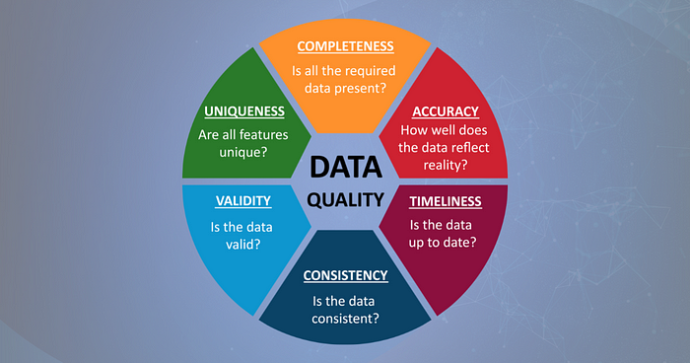

Slide 3
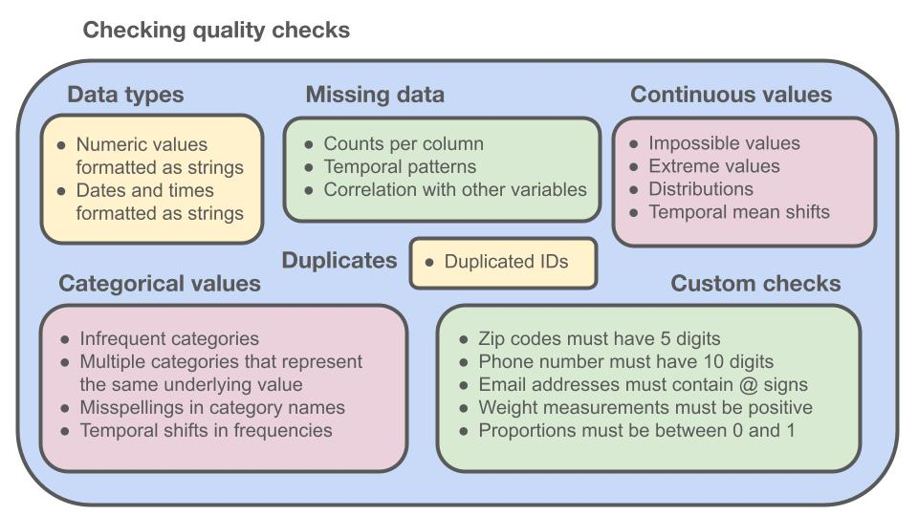

Slide 4
